Slide 1
Executive Summary

Slide 2
Discovery & Assessment of Rehosting a sample Application (Hyttebooking)
Objective: In the pursuit of digital transformation and operational efficiency, Gassco has started a POC initiative for the rehosting of the “Hyttebooking” application. The primary objective of this endeavour is to strategically rehost the identified application, leveraging cloud capabilities to enhance scalability, flexibility, and overall performance. Through a systematic assessment template, we aim to define a tailored migration strategy that ensures a seamless transition to the cloud while optimizing cost, minimizing downtime, and unlocking the full potential of modern cloud technologies. This executive summary encapsulates the key insights and recommendations derived from the meticulous examination of the existing application landscape, with a focus on transitioning to a cloud-native environment.
Discovery & Assessment Highlights
Application Inventory: A thorough cataloguing of the application components, dependencies, and infrastructure elements has provided a comprehensive understanding of the current state, laying the groundwork for a targeted migration plan.
Compatibility Analysis: Detailed compatibility assessments have been conducted to evaluate the application's adaptability to cloud environments, ensuring a smooth transition without compromising functionality or performance.
Performance Analysis: Performance analysis has been employed to gauge the application's behaviour under everyday conditions.
Cloud Compatibility: The applications has been assessed using a comprehensive questionnaire to ensure cloud combability.
Migration Readiness Assessment: From the work that has been done, working with stakeholders and using questionnaire, we understand the readiness for the application.

Slide 3
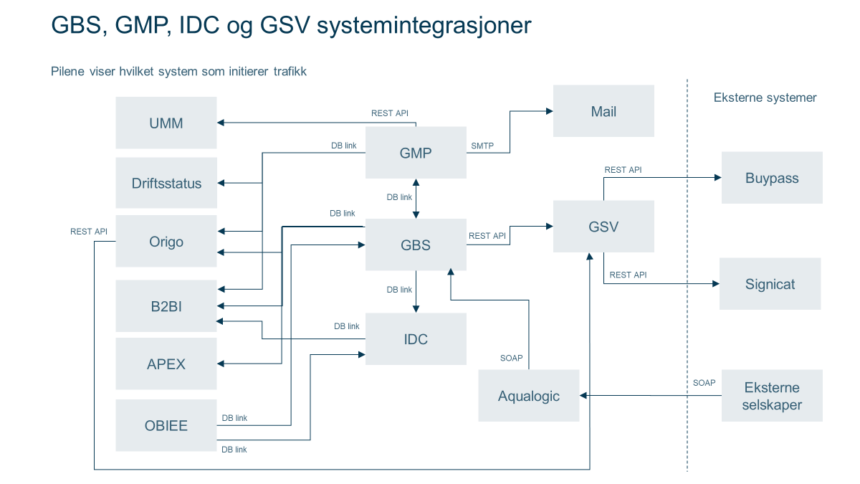
(R&D) Disaster recovery for on-prem workloads on the cloud platform
Objective: In response to the imperative to fortify business resilience and ensure uninterrupted operations, Gassco has embarked on a transformative journey to establish a Disaster Recovery (DR) strategy for on-premises workloads leveraging cloud infrastructure. The primary objective of the Disaster Recovery initiative is to transition on-premises workloads to the cloud, harnessing the agility, scalability, and redundancy offered by cloud platforms. By embracing a cloud-centric DR approach, Gassco aim to enhance recovery capabilities, minimize downtime, and fortify our overall business continuity posture.
Assess GBS to define DR Framework
Discoveries
Complex application infrastructure
Old solution, aprox. 20 years (With some technical debt)
Many dependencies
Oracle DB
Buypass via Signicat user identification
Backup to Oracle DB Backup (DR), and IBM Spectrum Protect (“Normal backup”)
RTO: 3 hr. RPO: 30 mins

Slide 4
Discovery & Assessment Highlights
Application Inventory: A thorough cataloguing of the application components, dependencies, and infrastructure elements has provided a comprehensive understanding of the current state, laying the groundwork for a targeted migration plan.
Compatibility Analysis: Detailed compatibility assessments have been conducted to evaluate the application's adaptability to cloud environments, ensuring a smooth transition without compromising functionality or performance.
Performance Analysis: Performance analysis has been employed to gauge the application's behaviour under everyday conditions.
Cloud Compatibility: The applications has been assessed using a comprehensive questionnaire to ensure cloud combability.
Migration Readiness Assessment: From the work that has been done, working with stakeholders and using questionnaire, we understand the readiness for the application.

Slide 5
Learning during Re-host sample workload from on-premises to cloud
The discovery and assessment phase of rehosting a sample application is a crucial step in understanding the existing landscape and formulating a strategic migration plan. There are learnings during this phase as mentioned below:
Application Dependencies and Interactions:
Learning: Uncovering the intricate dependencies and interactions among various application components.
Implication: Recognition of potential challenges during migration, especially when dealing with tightly coupled systems.
Legacy Infrastructure Nuances:
Learning: Discovering unique intricacies and idiosyncrasies within the current legacy infrastructure.
Implication: Understanding the need for customized migration strategies to accommodate legacy nuances and ensure a smooth transition.
Data Sensitivity and Compliance Requirements:
Learning: Identifying sensitive data and compliance requirements inherent in the application.
Implication: Necessity for robust security measures, stringent processes and compliance adherence during and after the migration process.

Slide 6
Learning during Re-host sample workload from on-premises to cloud
User Behaviours and Experience:
Learning: Gaining some insights into user behaviour and experience with the current application. (Mainly from user guide)
Implication: Factoring user expectations into the rehosting strategy to ensure a seamless transition and minimal disruption.
Integration Points with External Systems:
Learning: Mapping integration points with external systems and third-party services.
Implication: Ensuring continued interoperability and smooth functioning post-migration by addressing integration challenges proactively.
Documentation Gaps:
Learning: Recognizing gaps in existing documentation regarding application architecture and configurations etc.
Implication: Emphasizing the need for comprehensive documentation to facilitate a smooth migration process and ongoing maintenance.

Slide 7
Potential future blockers
No clear overall cloud strategy.
Need of an AD - DS / IAM strategy in cloud for migrated workloads before continuing migration work.
Clear processes for security approval of migration and operational tools, also security team is swamped.

Slide 8
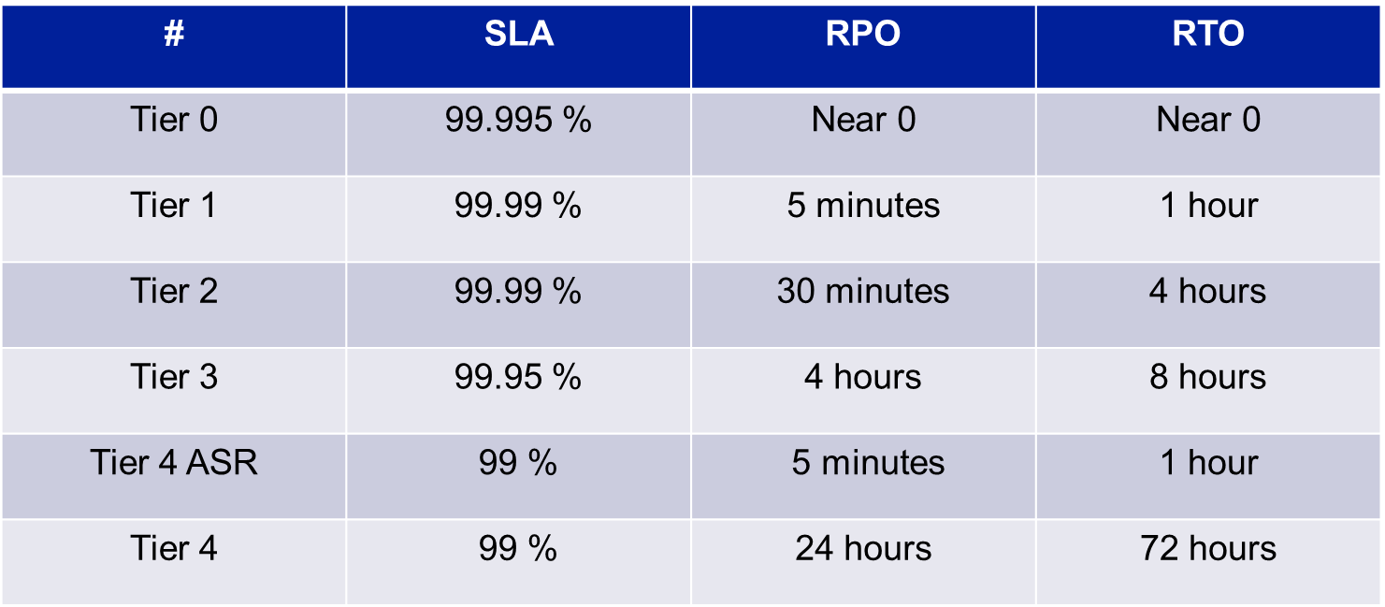
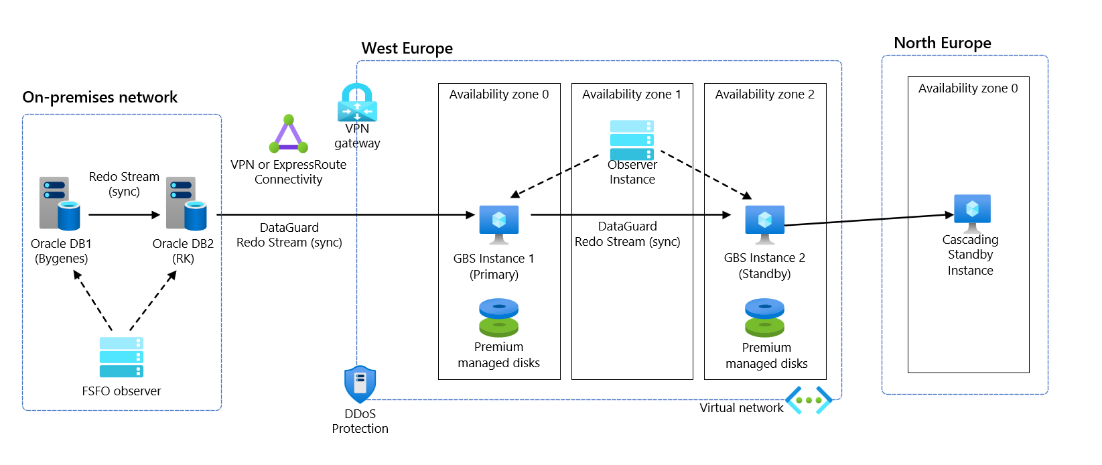
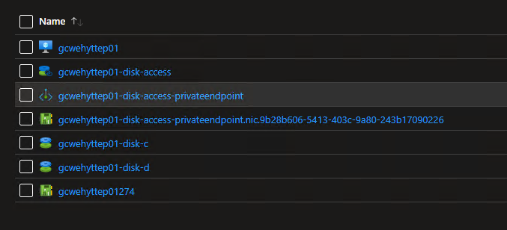
Some discovers and recommendations

Slide 9
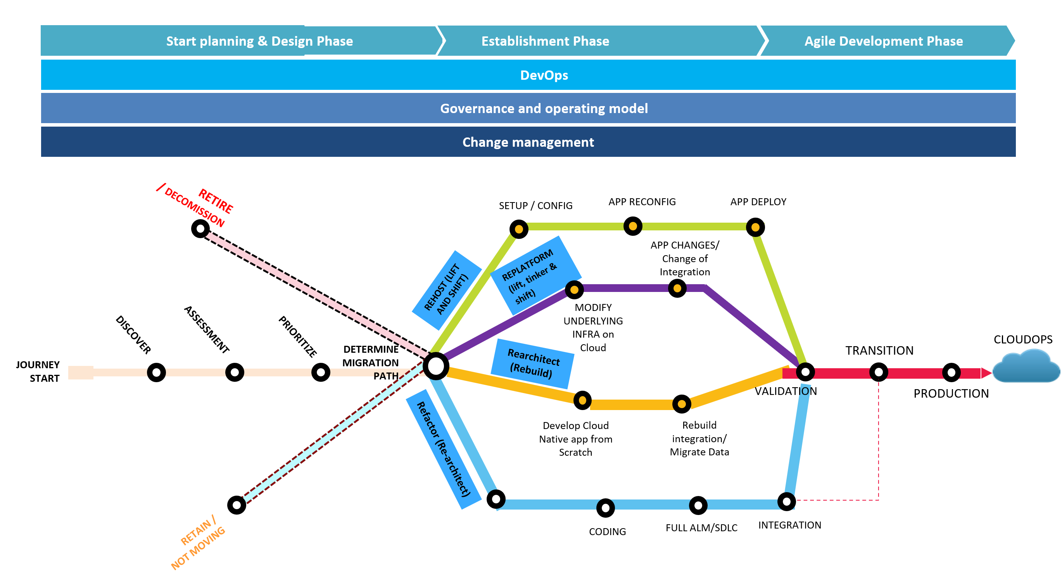
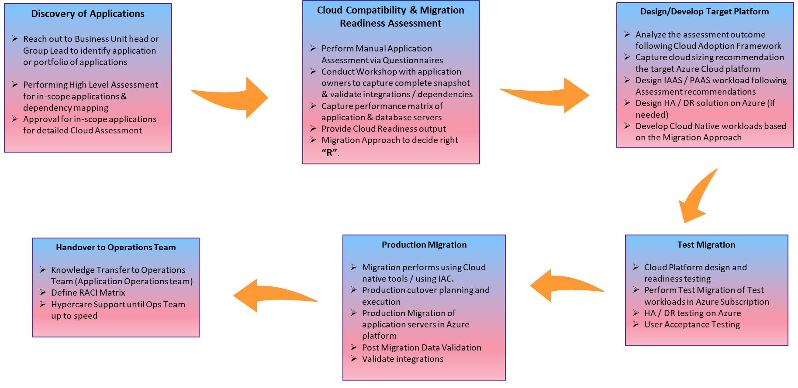
Proposed Gassco Enterprise Journey to Cloud has Multiple Paths

Slide 10
Assess GBS to define DR Framework
Discoveries
Complex application infrastructure
Old solution, aprox. 20 years (With some technical debt)
Many dependencies
Oracle DB
Buypass via Signicat user identification
Backup to Oracle DB Backup (DR), and IBM Spectrum Protect (“Normal backup”)
RTO: 3 hr. RPO: 30 mins

Slide 11
Assess GBS to define DR Framework
Copy data to Azure over VPN or ExpressRoute
Running several Availability zones in e.g., West Europe
With Cascading Standby instance in e.g., North Europe

